Slide 1

Grocery Store Analysis

Slide 2



About me
Name: S. Reddy Kishore
Degree: B.Tech (CAI)
College: MITS Autonomous College
Hello, my name is Reddy Kishore Seethi. I am a B.Tech graduated student in the stream of Computer Science and Artificial intelligence department from Mits college.
My primary motivation for pursuing data science is the desire to tackle complex, real-world challenges. I am fascinated by the power of data to reveal hidden patterns and provide evidence-based insights that can drive meaningful change.

Slide 3
Objectives of the Project
The main goal is to use SQL to analyze the grocery store's data and find ways to improve the business.
Analyze Sales: Find out which products sell best and identify sales patterns.
Understand Customers: Discover who the most valuable customers are and what they buy.
Improve Inventory: See which product categories are most popular to manage stock better.
Optimize Supplier Relationships: Evaluate which suppliers provide the most profitable and popular products to strengthen key partnerships and improve the supply chain.
Provide Recommendations: Use the findings to suggest ways to increase sales and customer satisfaction.

Slide 4
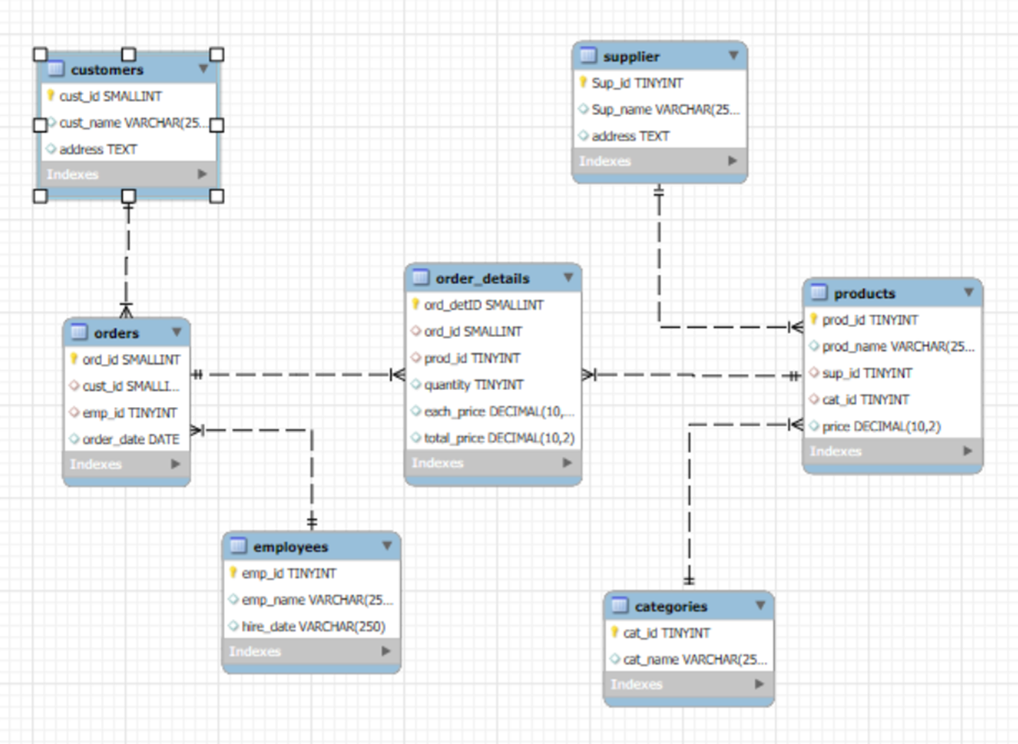
ER Diagram

Slide 5
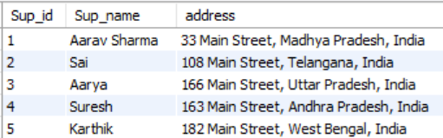
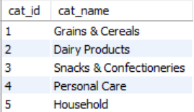
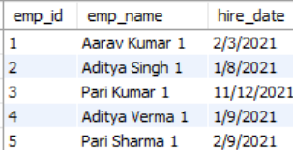
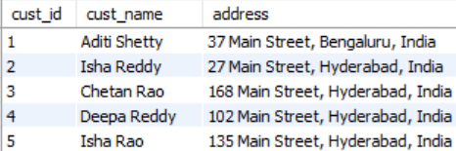
About Tables
Suppliers
Categories
Employees
Customers
Purpose: Holds information about the suppliers who provide the products.
Key Columns: Sup_id (unique ID for each supplier), Sup_name, address.
Purpose: Groups products into categories (e.g., "Dairy," "Bakery").
Key Columns: cat_id (unique ID for the category), cat_name.
Purpose: Stores information about the employees.
Key Columns: emp_id (unique ID for each employee), emp_name, hire_date.
Purpose: Stores information about each customer.
Key Columns: cust_id (unique ID for each customer), cust_name, address.

Slide 6
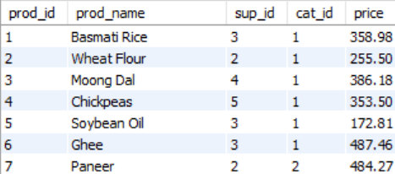
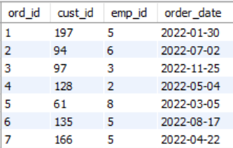
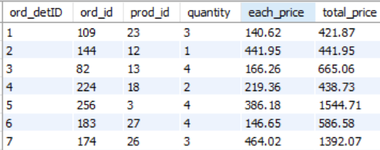
Products
Orders
Order Details
Purpose: Contains details for every product sold.
Key
Columns: prod_id (unique ID for each product), prod_name, price. It also links to its cat_id and sup_id.
Purpose: This is a core table that records every order placed. It acts as a link between customers and employees.
Key Columns: ord_id (unique ID for the order), cust_id (to know which customer ordered), emp_id (which employee handled it), and order_date.
Purpose: This table provides a detailed breakdown of each order, showing exactly which products and quantities were included.
Key Columns: ord_detID (unique ID for each line item), ord_id (to link to a specific order), prod_id (to link to a specific product)

Slide 7
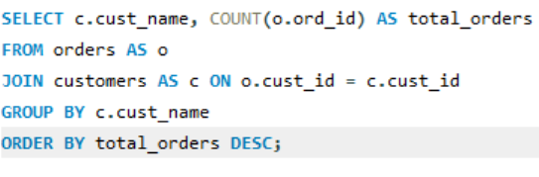
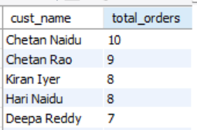
Key Analysis
The customers who placed the highest number of orders

Slide 8
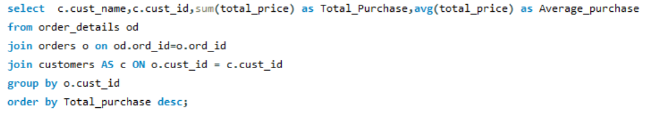
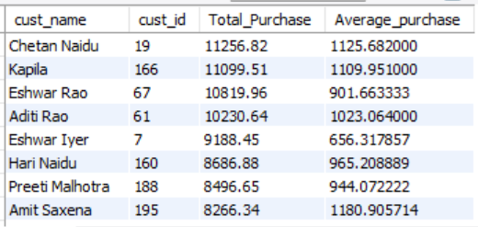
The total and average purchase value per customer

Slide 9
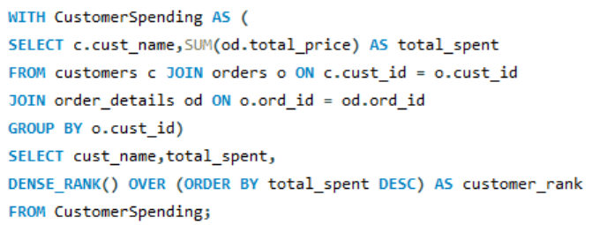
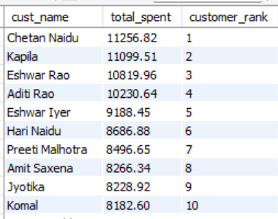
Ranking customers based on their total purchase amount

Slide 10
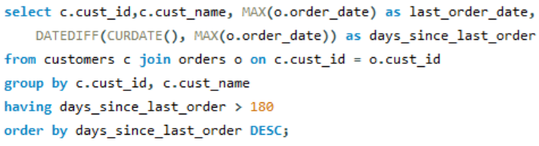
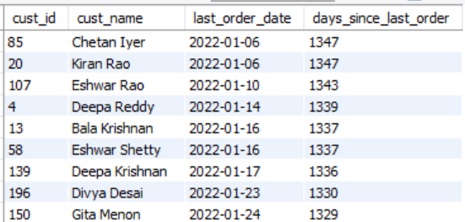
The Customers who didn’t made any purchase in last 180 days

Slide 11
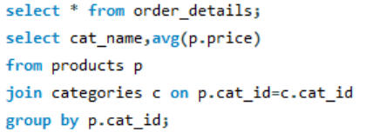
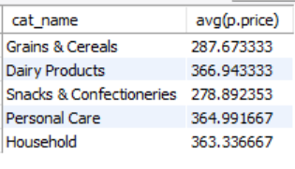
The average price of products by category

Slide 12
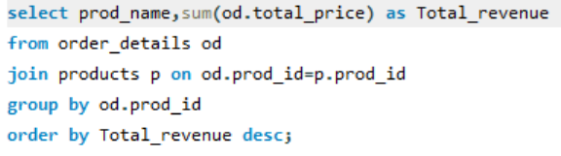
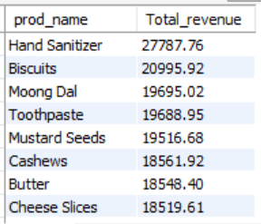
The total revenue generated by each product

Slide 13
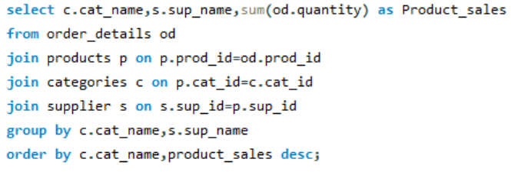
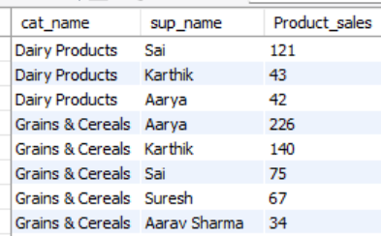
How the product sales vary by category and supplier (quantity)

Slide 14
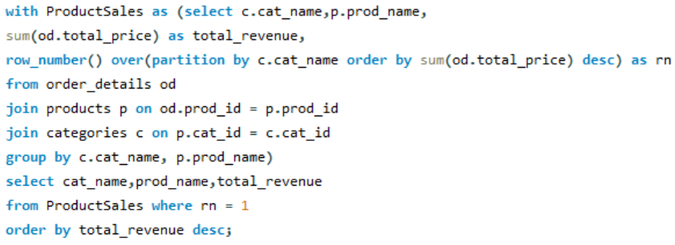
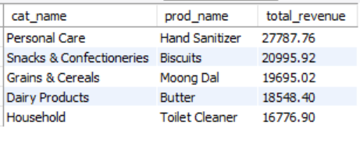
The best-selling product within each category based on total revenue

Slide 15
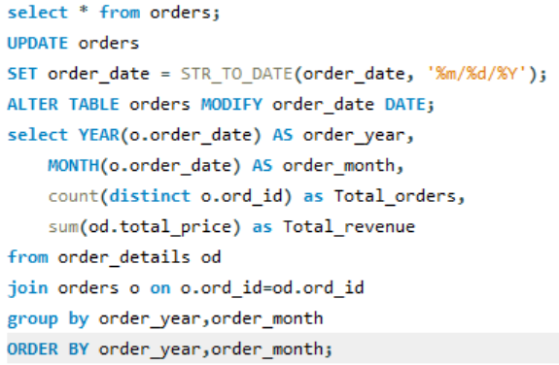
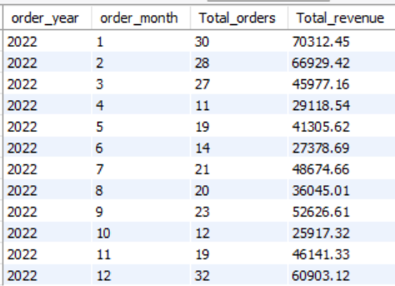
The monthly trends in order volume and revenue

Slide 16
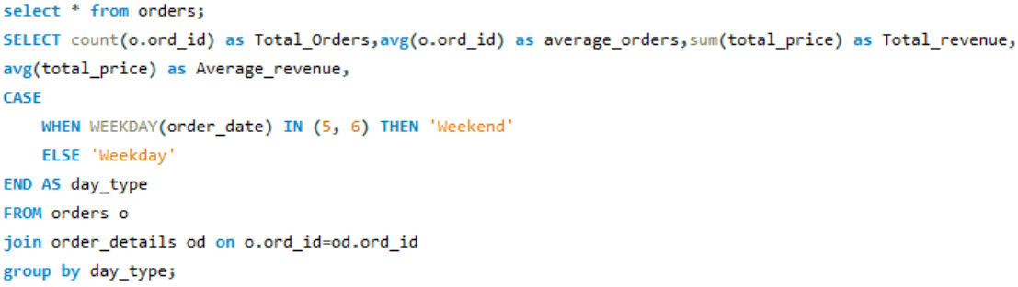

How do order patterns vary across weekdays and weekends

Slide 17
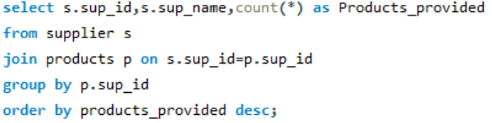
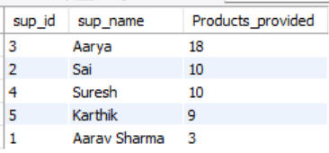
The Suppliers who provide most products

Slide 18
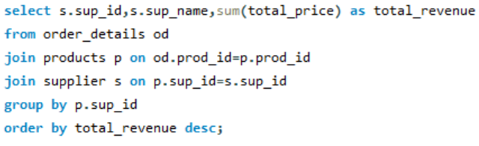
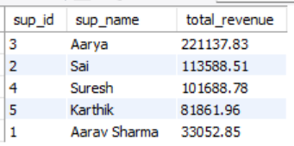
The suppliers who contribute the most to total product sales

Slide 19
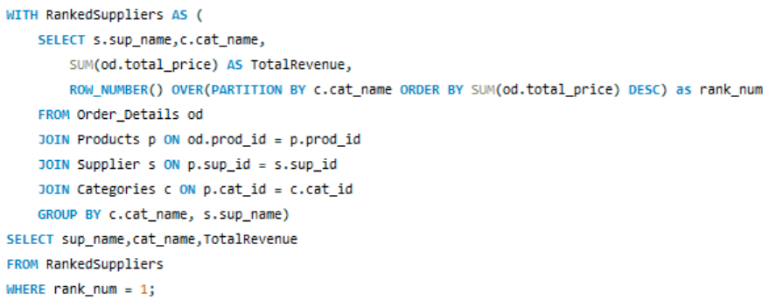
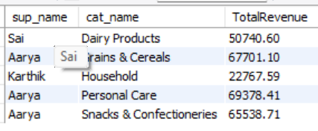
The supplier who contribute the most of revenue of a specific category

Slide 20
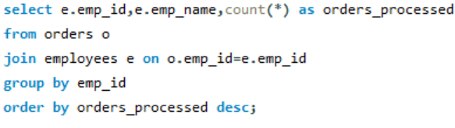
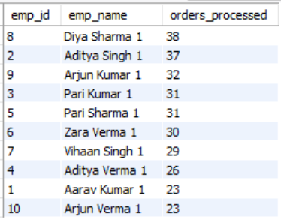
The total orders processed by each employee

Slide 21
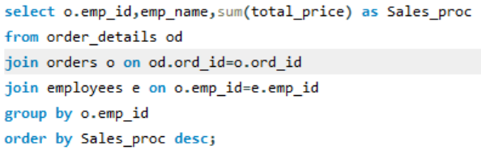
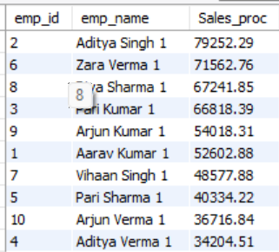
The total sales value processed by each employee

Slide 22
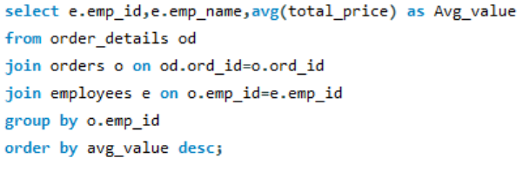
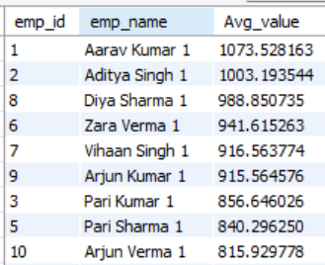
The average order value handled per employee

Slide 23
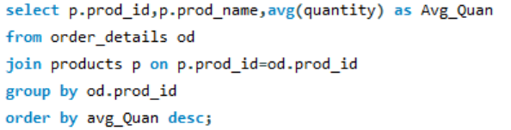
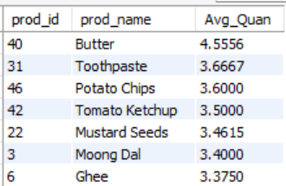
The average quantity ordered per product

Slide 24
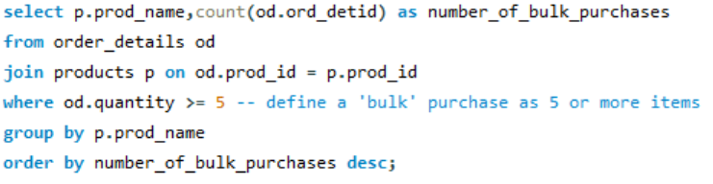
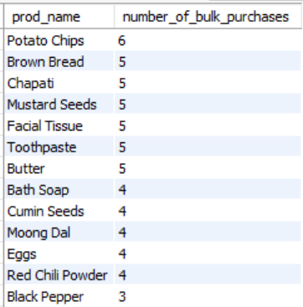
Products Most Frequently Purchased in Bulk

Slide 25
Challenges Faced :
Designing an Effective Database Schema: One of the initial hurdles was designing a database schema that could accurately represent the complex relationships between customers, orders, products, and suppliers. Ensuring that the tables were properly linked with primary and foreign keys was crucial for data integrity and for the success of the analysis. It required careful planning to avoid data redundancy and to make sure that all necessary business operations could be tracked.
Writing Complex SQL Queries with Multiple Joins: As the analysis questions became more detailed, the SQL queries required to extract the answers grew in complexity. For instance, to find out which supplier contributed the most to the sales of a specific product category, it was necessary to join multiple tables, including products, categories, supplier, and order_details. Structuring these joins correctly and ensuring they were optimized for performance was a significant challenge.

Slide 26
Key Insights :
Focus on High-Value Customers : A minority of customers generate the majority of the store's revenue. By identifying these top customers, the business can create targeted loyalty programs and personalized marketing campaigns. This will not only retain them but also encourage further spending, maximizing their lifetime value.
Promote High-Performing Categories : The "Personal Care" and "Grains & Cereals" categories are the primary revenue drivers. This insight allows the store to optimize inventory by ensuring these popular items are always in stock. Additionally, these categories should be featured in promotional materials and given prime placement in the store to further boost sales.
Strengthen and Diversify Supplier Relationships : A single supplier, Aarya, is the top revenue contributor across multiple key categories, highlighting a critical business dependency. The store should prioritize building a stronger partnership with Aarya. At the same time, it is essential to identify and onboard alternative suppliers for high-demand products to mitigate supply chain risks and maintain competitive pricing.

Slide 27
Conclusion :
This project successfully demonstrated how SQL can be used to transform raw sales data into valuable business intelligence. The analysis provided a clear view of the store's performance by identifying key trends and patterns.
Key Findings: We pinpointed our most valuable customers, identified the top-selling products and categories, and gained a better understanding of sales cycles.
Business Impact: These insights are directly actionable. They enable the store to make data-driven decisions regarding inventory management, targeted marketing campaigns, and strategic supplier relationships.

Slide 28

THANK YOU

